Slide 1

Setting a Network Using Four Labs With Different Network
Team Members
Achint Sathoo - 2020A1R132
Pranoy Bhan - 2020A1R114
Aryan Sharma – 2020A1R133
Kavya Dhar - 2020A1R112
DEPARTMENT OF COMPUTER SCIENCE AND ENGINEERING
MIET(Autonomous), JAMMU

Slide 2

Contents
Introduction
Networking Device Used
Connecting Wire Used
Network Structure
Demonstration

Slide 3
Introduction
In this project we are setting up LAB network so that each LAB can communicate with each other easily.
Here each LAB in is on different network and we are connecting different network using router and using RIP protocol to route the packets.
Also covering both wired and wireless connection in a LAN which is established within different labs.
We have also established a server so that each PC in network can request the service like SMTP service.

Slide 4
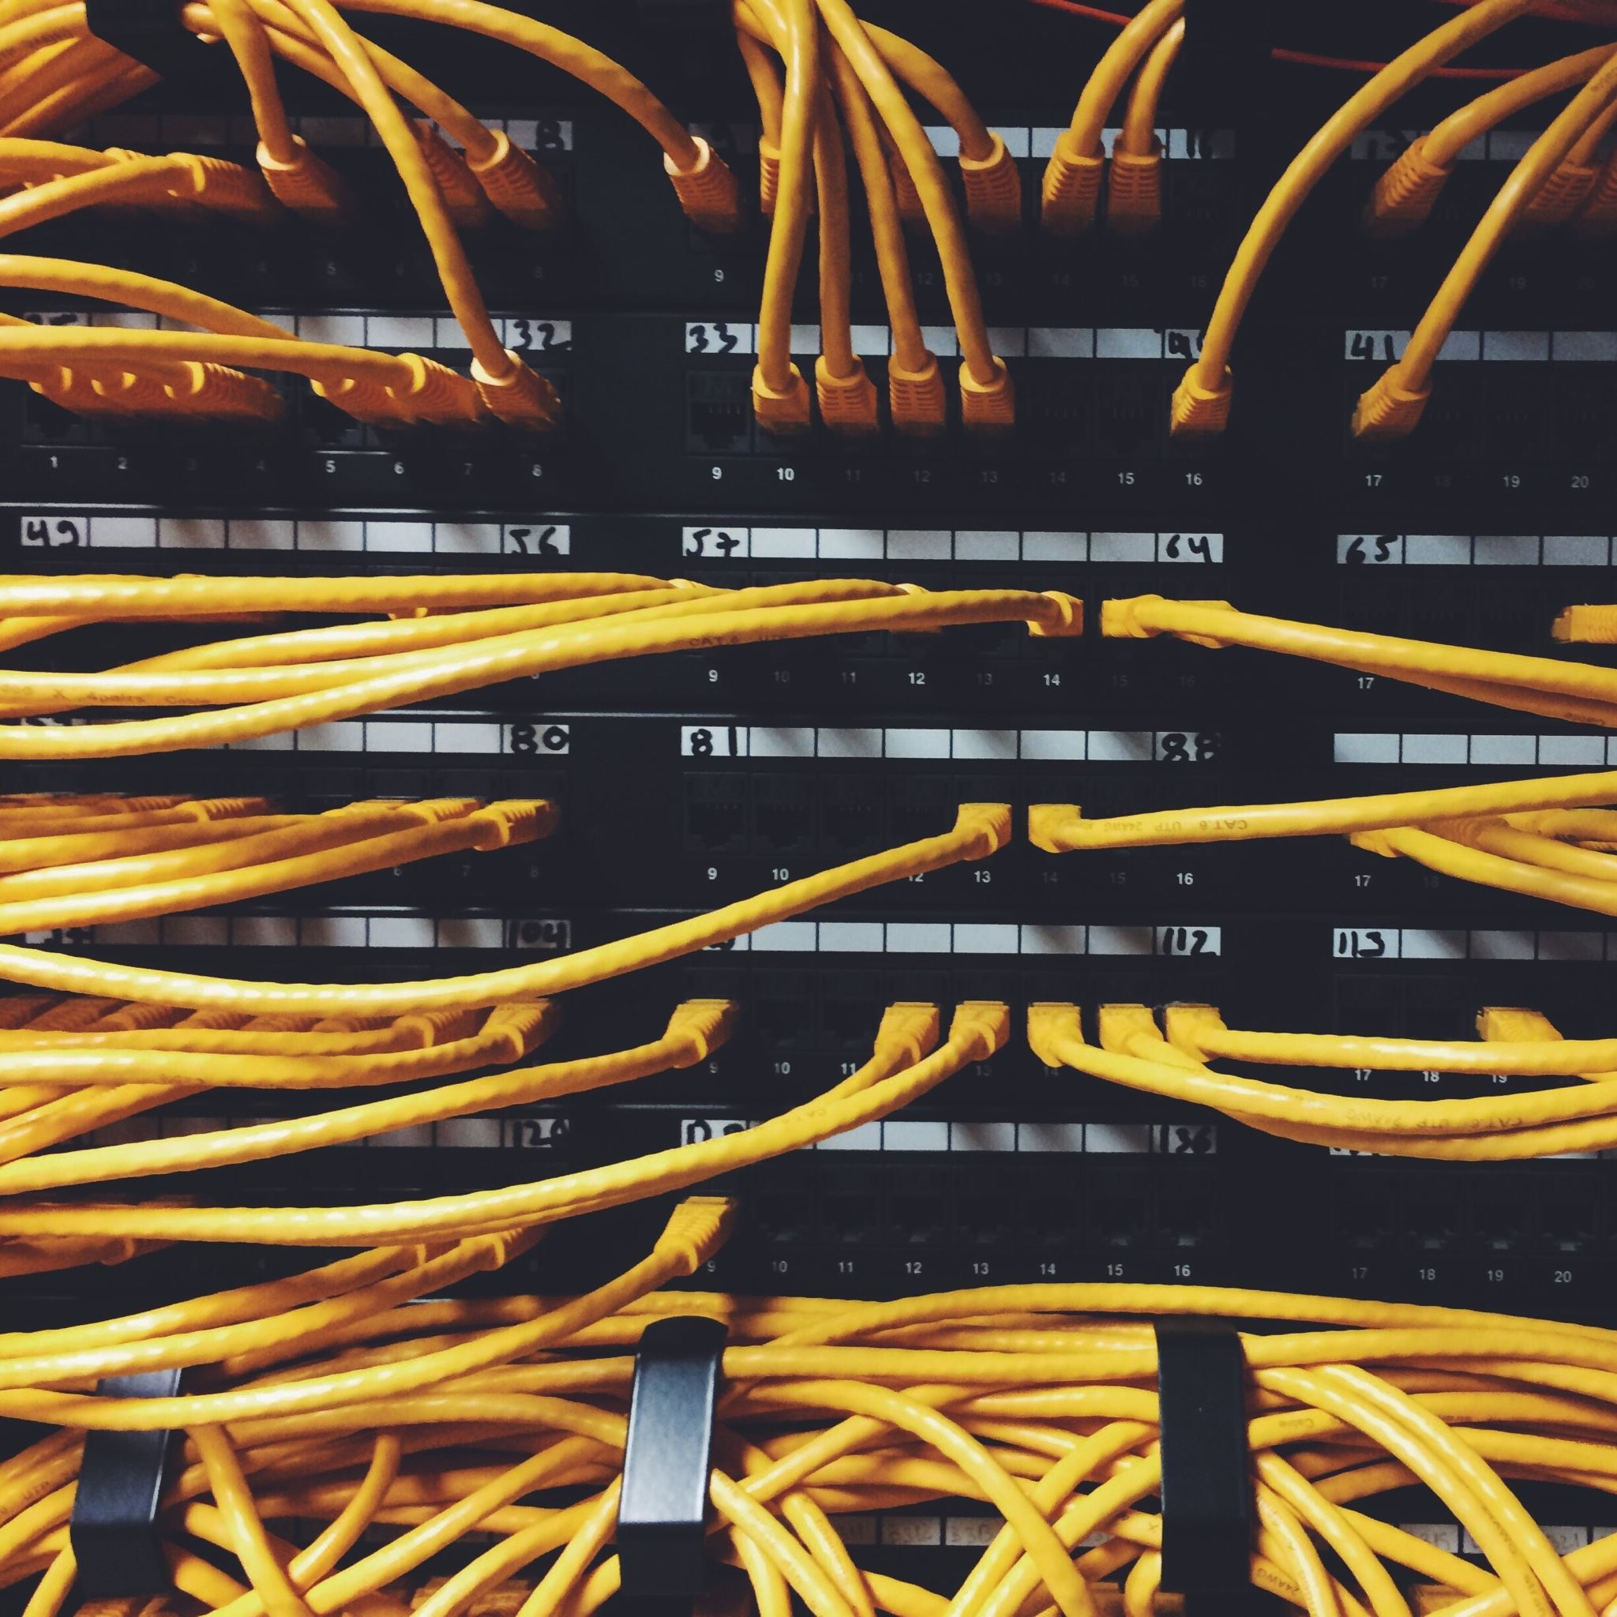
Networking Device Used
Router
Switch
Wireless Access Point

Slide 5

Connecting Wire Used
Straight-Through Cable
Cross-Over Cable
Serial DCE Cable

Slide 6


Network Structure
Lab-2
Lab-4
192.168.2.0
192.168.4.0
Server
Lab-1
Lab-3
192.168.1.0
192.168.3.0

Slide 7

Server Name: gmail.com
IP Address:192.168.4.18
DNS Server
SMTP
Incoming Server
SMTP
POP3
Outgoing Server

Slide 8

DEMONSTRATION

Slide 9


